Slide 1
Division of Water Restoration Assistance
Funding Overview
December 2016

Slide 2
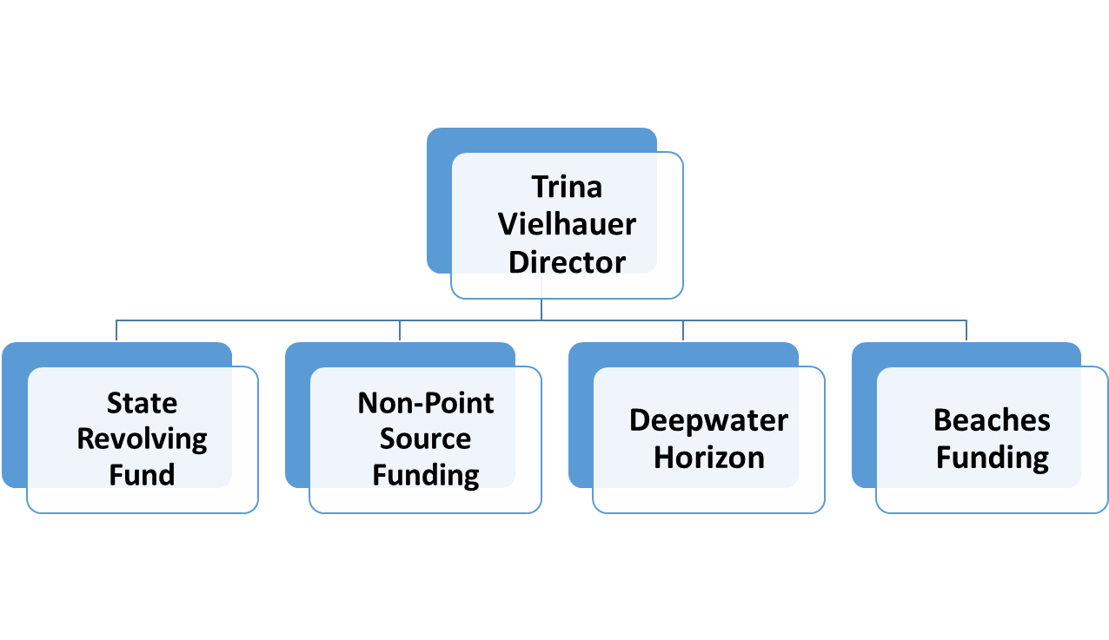
Water Restoration Assistance

Slide 3
Division Priorities
Timeliness and process consistency
Leveraging staff resources
Coordination with stakeholders
Managing special projects
Water-related legislative appropriations
Springs appropriations
Create funding opportunities
Notes:
How can the Division get money to the communities more effectively?

Slide 4
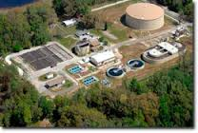
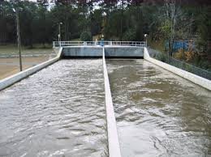
State Revolving Fund
Drinking water:
Preconstruction loans
Construction loans
Clean water:
Planning loans
Design loans
Construction loans
Small community grant program:
Grant combined with a loan
Principal forgiveness
Disadvantaged communities
Notes:
Low interest loan program historically focused on water pollution control facilities-- primarily drinking water and clean water.
Federally funded with about 20% state matching funds.
As loans are repaid, funds are made available to loan for new projects.
About $4B has been loaned to date. Eventually, program will be self sustaining and will not need annual federal and state additions.
SRF has a small communities grant program- essentially a principal forgiveness program, for disadvantaged communities.

Slide 5
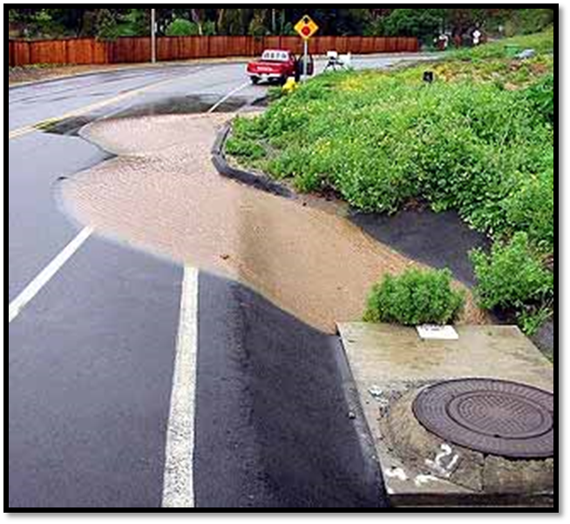
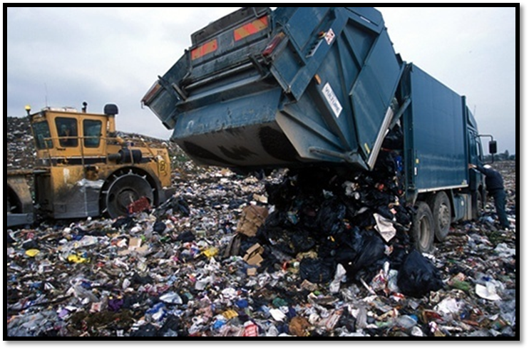
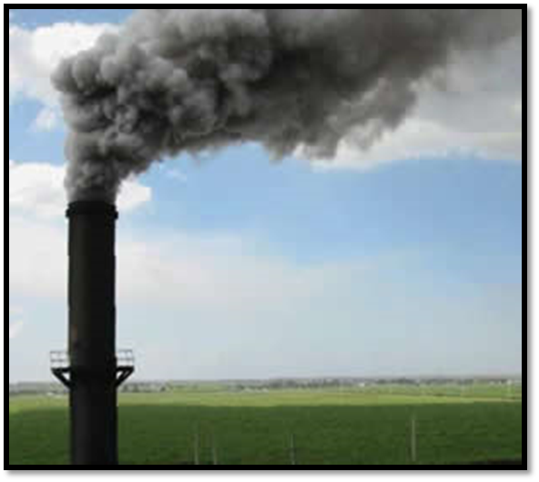
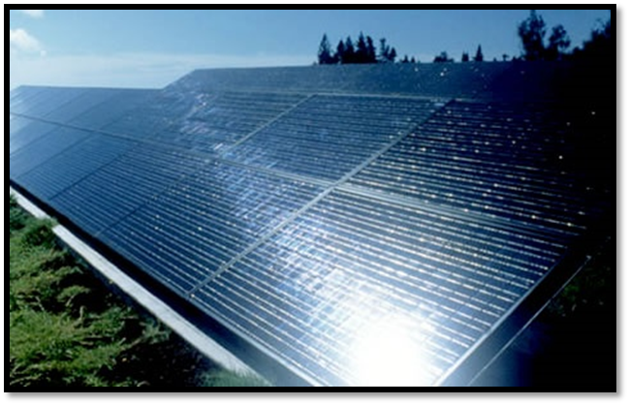
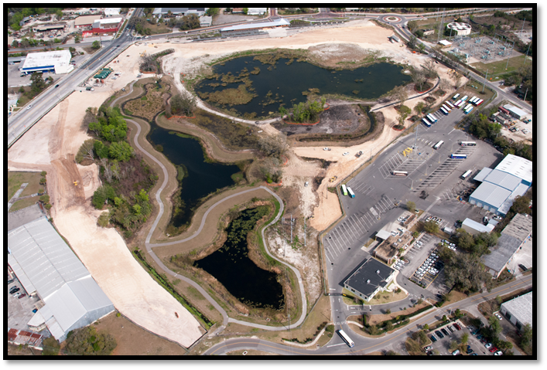
SRF Innovative Projects
Notes:
Some creative uses of the program have involved…
Storm water management…with a water quality component.
Landfill management – when no National Pollutant Discharge Elimination System (NPDES) permit is required.
Atmospheric deposition reduction projects- when clear connection between manmade pollution and water quality is demonstrated.
Green Power consumption or production projects.
Conversion of Brownsfield site- following remediation, site was converted into stormwater management system.

Slide 6
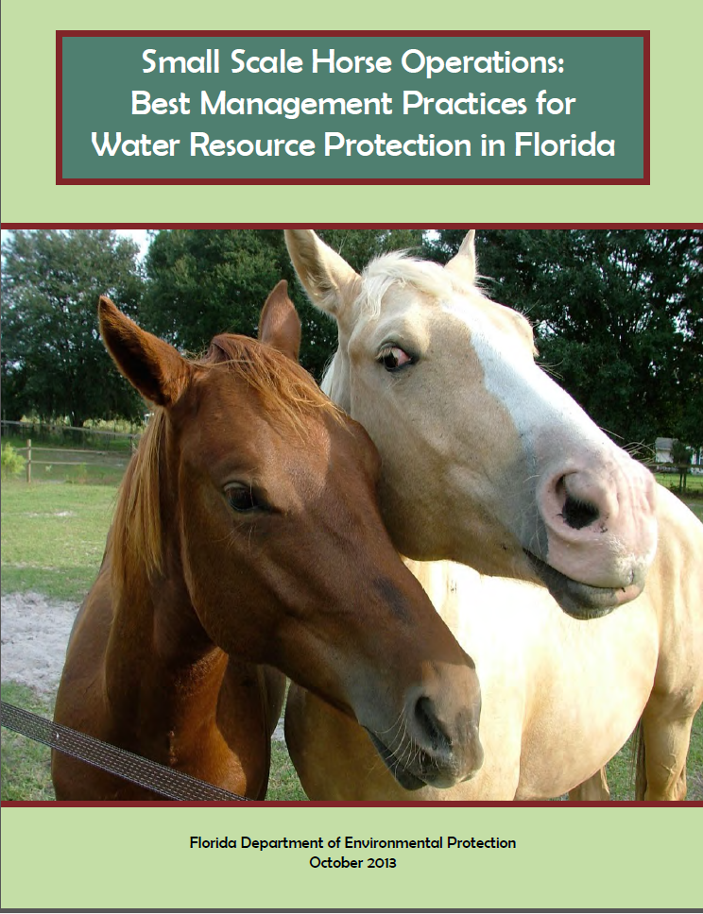
Non-Point Source Grants
Emphasis is placed upon:
Addressing pollutants in impaired water bodies
Implementing watershed plans
Use of innovative BMPs
Public education & training
“Prior to entry into a major conveyance system”

Slide 7
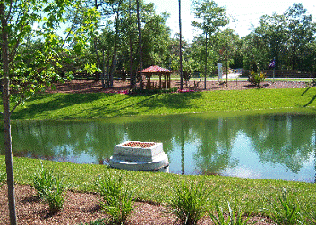
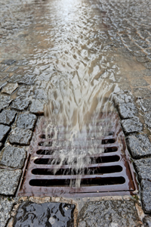
319(h) & TMDL Grants
319(h) EPA Clean Water Act Grant
Federally funded grant
~$5 million annually
40% match requirement
TMDL Water Quality Restoration Grant
State funded grant
$3 million annually
50% match requirement
Notes:
Program mostly funds Urban Stormwater Projects-
BMP construction for stormwater treatment, like bioswales, wet detention ponds, low impact design, wetland restoration
But can also fund:
Septic Tank Pollution Abatement Projects
Agricultural BMP Development, Monitoring &/or Evaluation
Silvicultural Best Management Practices (BMPs)
Erosion / Sediment Control

Slide 8
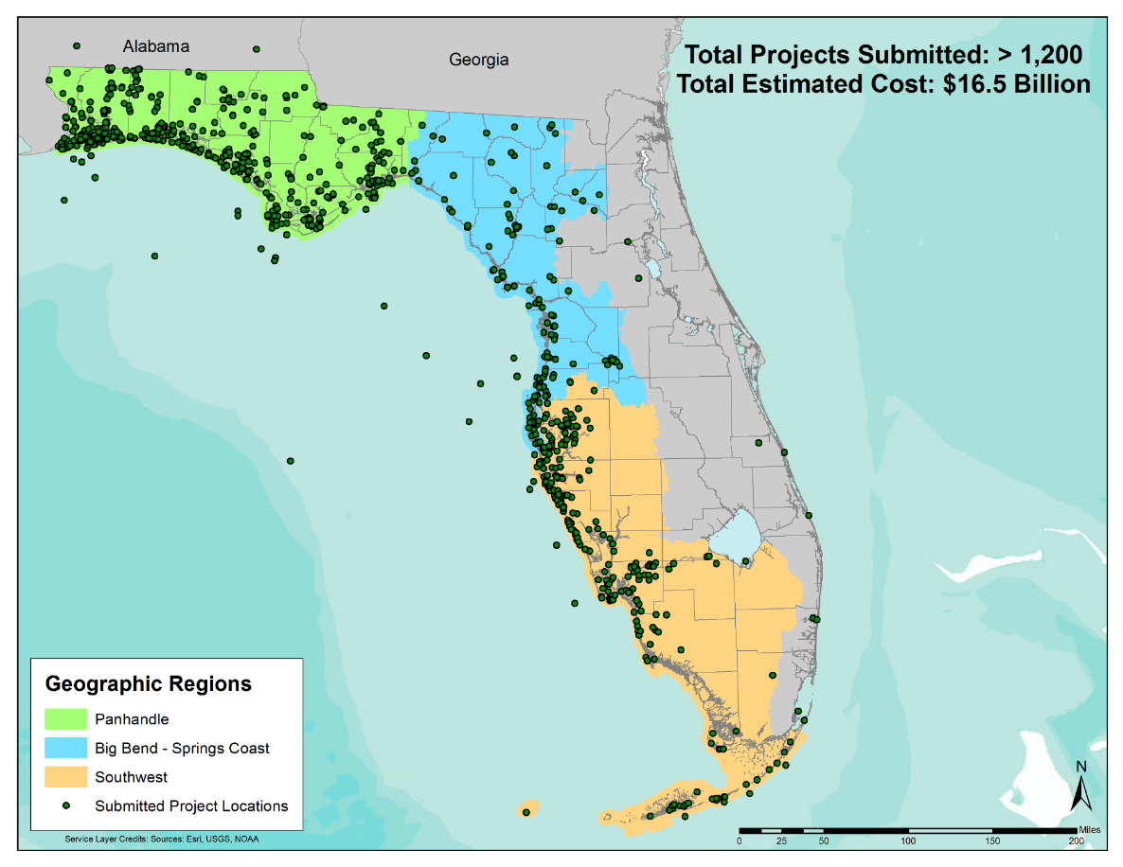
Deepwater Horizon Unit
(NRDA) Natural Resource Damage Assessment
(NFWF) National Fish and Wildlife Foundation -Gulf Environmental Benefit Fund
(RESTORE) Resources and Ecosystems Sustainability,
Tourist Opportunities, and
Revived Economies of the
Gulf Coast Act of 2012
Notes:
In 2015, the BP settlement identified approximately $18 BILLION in economic claims, between Clean Water Act Penalties, NRDA, State and Local Agencies
About $2B is anticipated to flow into the state of Florida for restoration.

Slide 9
Funding Sources and Project Types
NRDA | NFWF | RESTORE
Provides off-set to injuries from spill | Benefits natural resources of the Gulf Coast that were impacted by the spill | Overall restoration of Gulf of Mexico – not limited to spill impacts
Species injured include birds, turtles, fishes, mammals | Remedy harm and to eliminate or reduce the risk of future harm to Gulf Coast natural resources | Pot 1 – Ecological and economic restoration
Habitats injured include seagrass, oysters, marsh, dunes | Restore and maintain the ecological functions of landscape-scale coastal habitats | Pot 2 – Science-based to restore and protect natural resources
Off-sets can include lost recreational or human use | Replenish and protect living resources | Pot 3 – Ecological and economic restoration
 | Can fund water quality projects that have direct links to habitats and species
Notes:
NRDA- Provides funds to off-set injuries (species, habitat, and human use)
NFWF- Benefits Natural Resources- restoration to impacted resources
RESTORE- ecological and economic restoration not limited to damages sustained in the oilspill

Slide 10
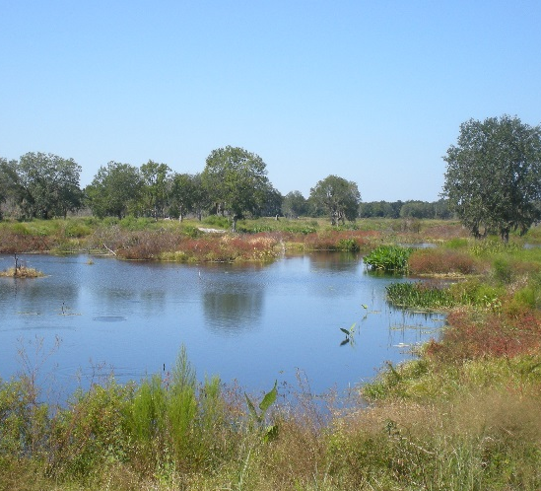
Nonmandatory Land Reclamation
Who: Private Land owners of lands mined prior to regulatory requirement for reclamation
What: Voluntary reclamation where costs often exceed land value
Where: Eligible phosphate mines disturbed between 1910 and 1975
When: Program began disbursing funds in 1983
Why: To improve environmental and economic utility of lands by removing safety hazards and improving water quality and quantity.

Slide 11
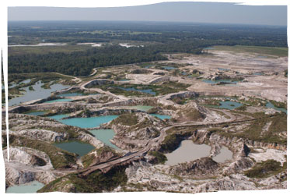
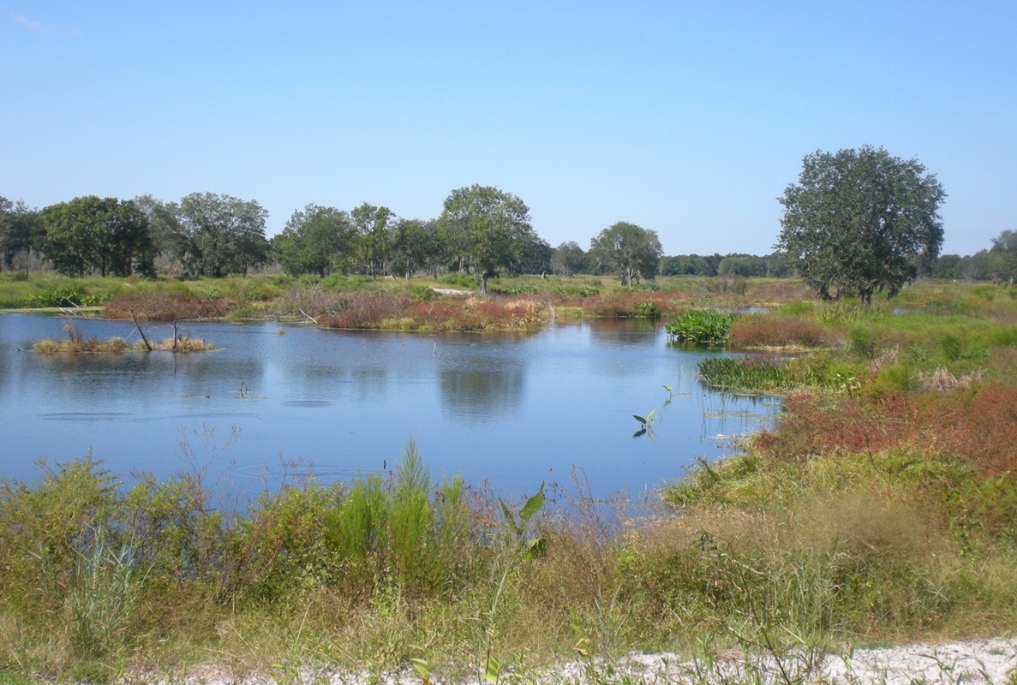
TENOROC FISH & MANAGEMENT AREA CLEARING & EARTHMOVING ACTIVITIES (APRIL 2010) – CONSTRUCTION OF EAST WATERFOWL AREA (Post reclamation)
Land Reclamation
During
AFTER

Slide 12
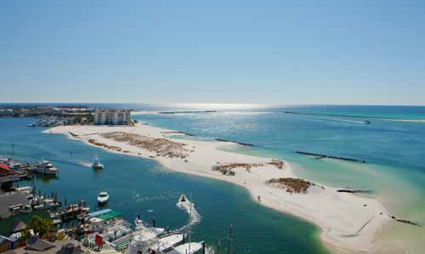
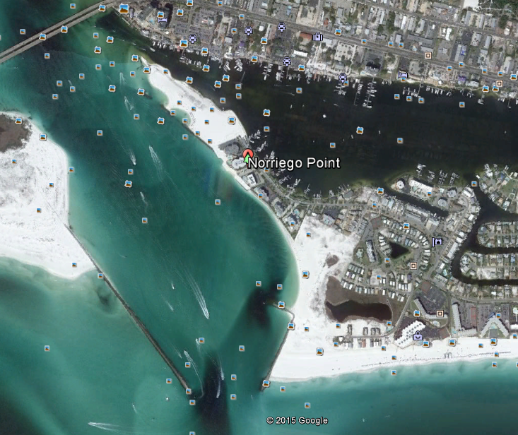
East Pass IMP/Norriego Point
Notes:
In 2013, the East Pass Inlet Management Plan (IMP) was adopted, recommending stabilization of the Point. The stabilization has been permitted but the City of Destin also will wished to include recreational amenities, such as a pavilion, restrooms, signage, trails & additional parking.
The City received funding through NRDA for the entire project. Should construction come in over budget, the project has an inlet management appropriation that can be used for activities adopted in the IMP.
Coordination: Since the NRDA funds were neither state nor federal, they can be used as local match for the Inlet Management grant.

Slide 13
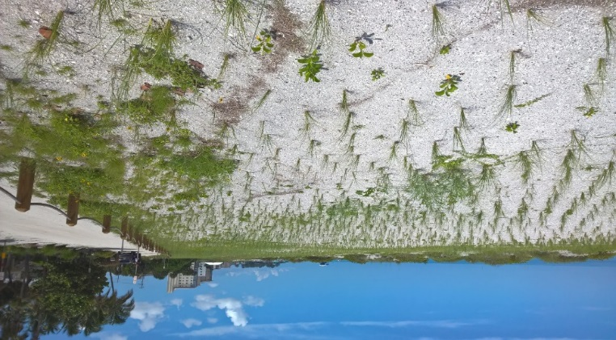
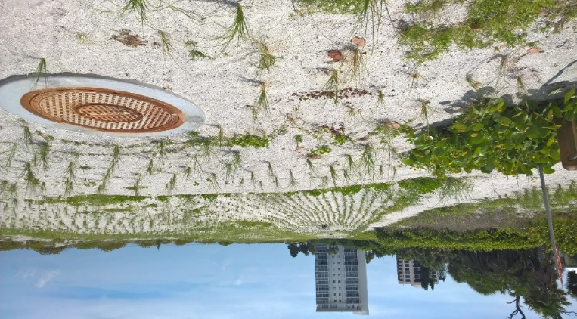
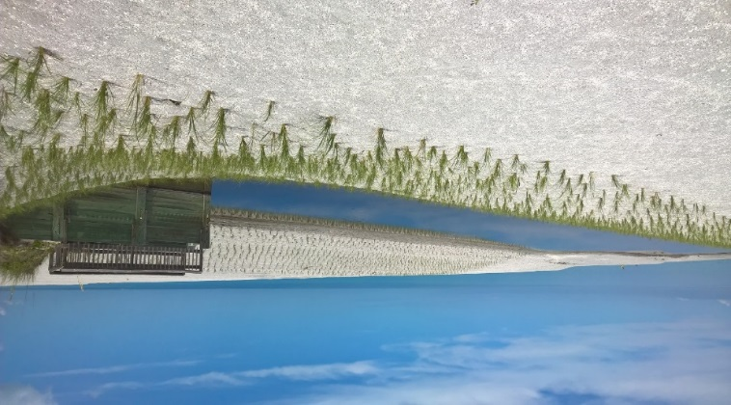
Venice Beach Nourishment/ Stormwater Improvements
Notes:
The City of Venice recently completed a beach nourishment project, using state matching funds. Like many coastal communities, the design needed to incorporate stormwater outfalls.
In order to improve water quality at the outfalls, the City applied for and received a WMD stormwater grant & a 319 grant that were combined to build (2) diversion pump systems (WMD grant) and bio-retention swale (BMP- 319 grant). The combination provided stormwater treatment and volume reduction at the beach outfall.
As you can see, the outfall was vegetated for stabilization and incorporated into the beach project design.

Slide 14
Other Activities
FY15-16: 84 legislative water projects
FY16-17: 131 legislative water projects
FY15-16: $41 million springs projects
FY16-17: $50 million springs projects

Slide 15
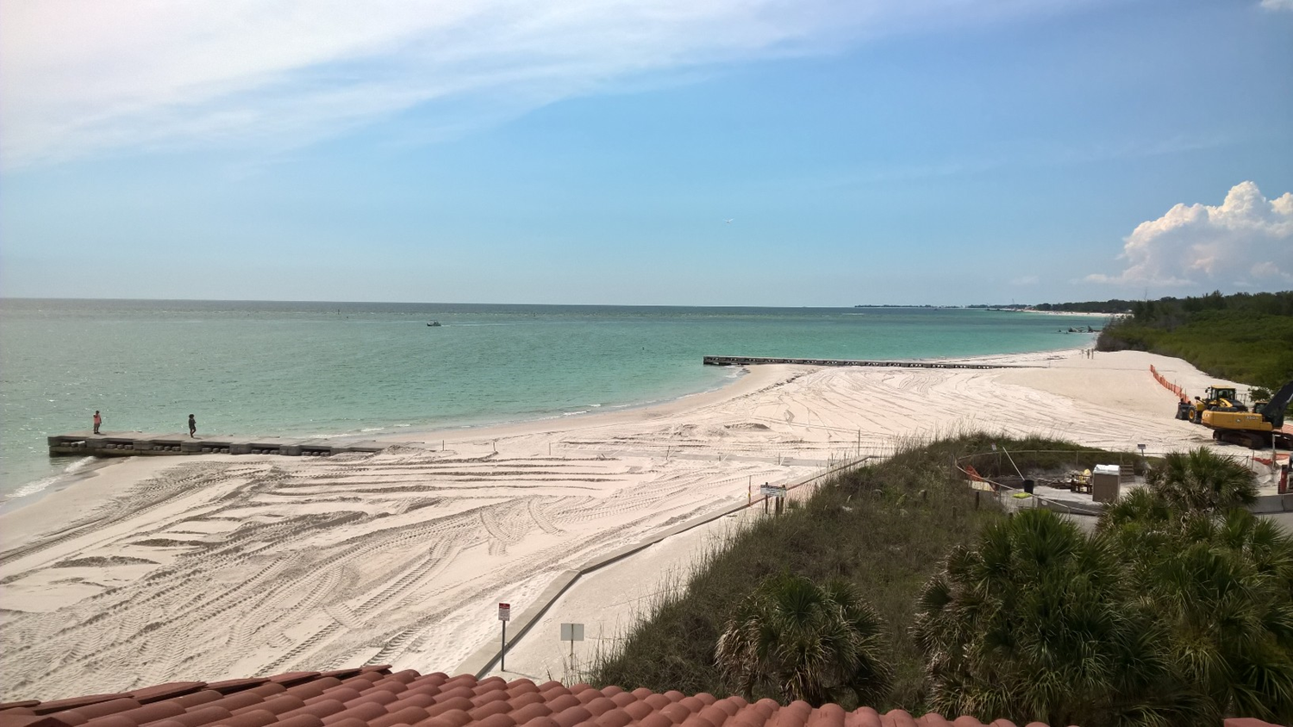
DWRA Contacts
Director
Trina Vielhauer (850) 245-2998,
trina.Vielhauer@dep.state.fl.us
Deepwater Horizon Unit:
Phil Coram: (850) 245-2167
Phil.Coram@dep.state.fl.us
Beaches & Mines Funding:
Alex Reed: (850) 245-2980
alex.reed@dep.state.fl.us
DEP 319/TMDL Grant:
Kate Merchant: (850) 245-2952
Kathryn.Merchant@dep.state.fl.us
State Revolving Fund:
Tim Banks: (850) 245-2969
Timothy.Banks@dep.state.fl.us

