Slide 1
Mosquito Control Funding in Florida
Andrea Leal
Florida Mosquito Control Association
Vice President
Legislative and Regulatory Committee Co-Chair

Slide 2
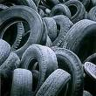
How Florida District Funding Works Solid Waste Tire Fund
Waste Tire Collection Fees
Collected by Department of Environmental Protection (DEP)
“Up to 14% of funds collected shall be…provided to FL Dept. of Agriculture (FDACS) for mosquito control…especially for control of West Nile Virus”
DEP passes funds on to FDACS to manage and distribute
Notes:
Amount allocated by FL Statute 388

Slide 3
DEP
FDACS
MCDs
University of Florida Medical Entomology Lab
Research Grants
Notes:
DEP collects the money
Legislation dictates how much money is then passed through FDACS
Legislation and rules dictate how FDACS distributes

Slide 4
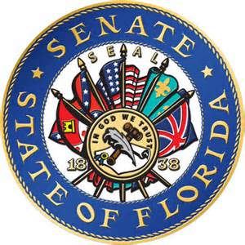
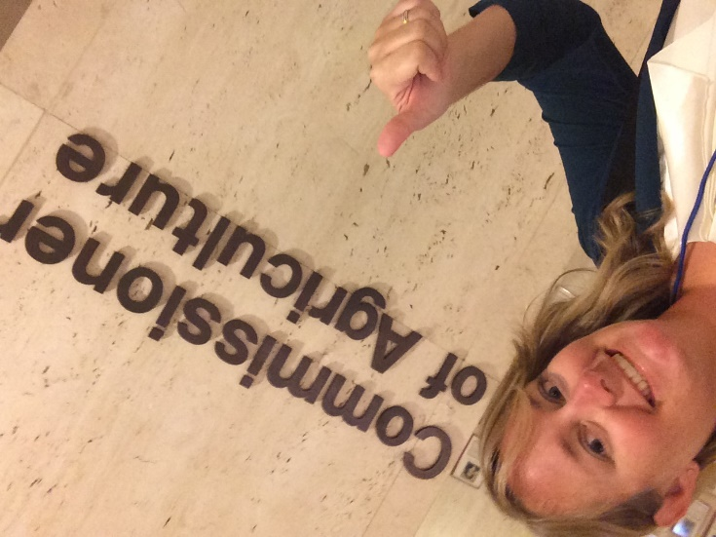
Annual Trip to Tallahassee
Approximately 50 participants
Mosquito Control Personnel
Industry
Research Institutions
Organized by FMCA Lobbyist
Appropriations Committee Members
Education Committee Members
Local Legislator Offices
Notes:
This year we visited the offices of just under 100 senators and representatives, which is really good considering there are 164 offices.
Talking points this year: FUNDING, FUNDING and more FUNDING
We were a little late in the game this year, but in the upcoming year we will continue to push for higher $$
We also met with Commissioner of Agriculture who was very supportive of our goals

Slide 5
Historical Funding in Florida 2007
Program | Distribution Amount
State Aid to Programs | $1.91M*
Earmark for Research | $250,000
PHEREC Lab (FL A&M) | $1.4M
FMEL (UF) | $1.6M
TOTAL | $5.46M
*Approximately $35,000/program

Slide 6
Historical Funding in Florida 2011
Program | Distribution Amount
State Aid to Programs | $1.04M*
Earmark for Research | $250,000
PHEREC Lab (FL A&M) | $0
FMEL (UF) | $1.2M
TOTAL | $2.49M
55% Decrease
*Approximately $35,000/program

Slide 7
Historical Funding in Florida 2012
Program | Distribution Amount
State Aid to Programs | $1.91M*
Earmark for Research | $250,000
FMEL (UF) | $0
TOTAL | $2.16M
*Approximately $35,000/program
Notes:
Governor vetoed $1M earmarked for research

Slide 8
Historical Funding in Florida 2013 – 2016
Program | Distribution Amount
State Aid to Programs | $1.79M*
Earmark for Research | $500,000
FMEL (UF) | $500,000
TOTAL | $2.79M
*FMCA with FDACS create a tiered distribution of monies
Tier 1 (Programs over $3M): No funding
Tier 2 (Programs between $1M-$3M): 30% of funding = $43,000
Tier 3 (Programs less than $1M): 70% of funding = $32,000

Slide 9
FMCA Asks for this Year
Program | Distribution Amount
State Aid to Programs | $1.79M* ⬆ to $3.29M
Earmark for Research | $500,000
FMEL (UF) | $500,000 ➔ $0
TOTAL | $3.79M
*FMCA with FDACS create a tiered distribution of monies
Tier 1 (Programs over $3M): No funding
Tier 2 (Programs between $1M-$3M): 30% of funding = $82,000
Tier 3 (Programs less than $1M): 70% of funding = $68,000

Slide 10
Future Plans
Work with FDACS on distribution rule
Change 70/30 to 80/20
Change in waste tire definitions

Slide 11
State Zika Funding Florida Keys Mosquito Control Perspective
Governor Scott approved State funds
Department of Health allocates funds
Tier system based upon risk
Register as a vendor
Submit monthly invoices
Reimbursement of funds up to certain amount

Slide 12
State Zika Funding Florida Keys Mosquito Control Perspective
Tiers decided in August
Circumstances changed, monthly allocations didn’t
Meeting next week to discuss challenges/suggestions
MCD’s
DOH
FDACS

Slide 13
FMCA Legislative & Regulatory Committee Members
Andrea Leal (Co-Chair)
aleal@keysmosquito.org
Jeanne Moeller (Co-Chair)
Ben Brewer
Beth Carey-Kovach
Doug Carlson
Mark Cothran
Sandra Fisher
Wayne Gale
Flo Jones
Jeanne Moeller
Jorge Rey
Dennis Moore

