Slide 1
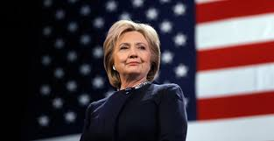
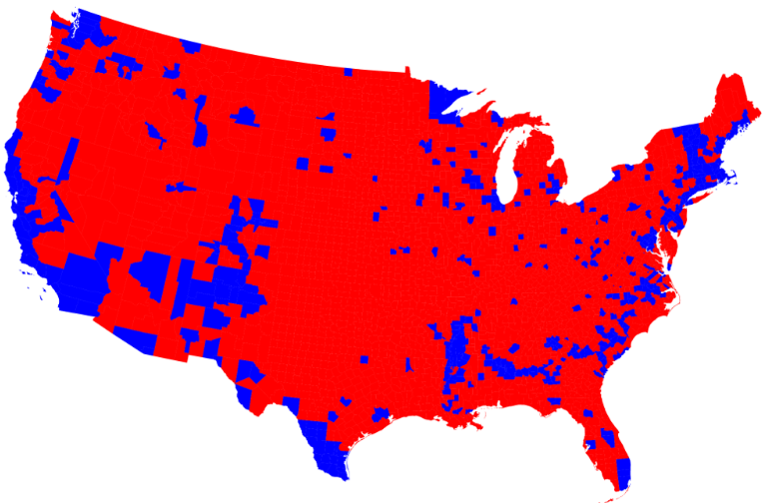
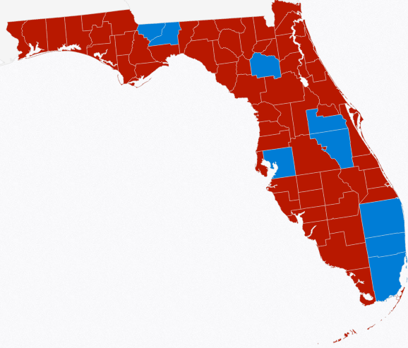
Election 2016: An Analysis of US & Florida Results
“Stronger Together”
“Make America Great Again”
Aubrey Jewett, PhD
University of Central Florida
Department of Political Science

Slide 2
Trump Wins Electoral College, Loses Popular Vote Republicans Dominate State and National Elections Pre-election Polls Are Usually Accurate, Except When They’re Not
National polls accurate (Clinton “won”), but national popular vote doesn’t matter.
Trump is president because he won the most electoral votes including Rust Belt upsets (most state polls were accurate, but Rust Belt state polls underestimated Trump vote).
FL “swung”, Trump won, polls were accurate, and FL’s #1 (as a battleground).
GOP keeps the majority in the US Senate, Dems under perform expectations.
Rubio wins FL US Senate seat (outpolls Trump in FL), polls were accurate.
GOP keeps strong majority in the US House, Dems under perform expectations.
FL congressional: 4 toss ups, GOP maintains lead (Dems gain 1), new faces/diversity
Republicans dominate state government nationwide (legislatures/governors).
FL legislature remains under firm GOP control, FL GOP closes gap in voter registration.
FL Constitution: Medical Marijuana Yes, Deceptive Solar No, Tax Breaks Yes.

Slide 3
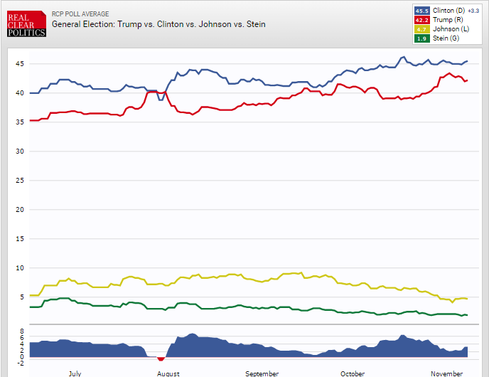
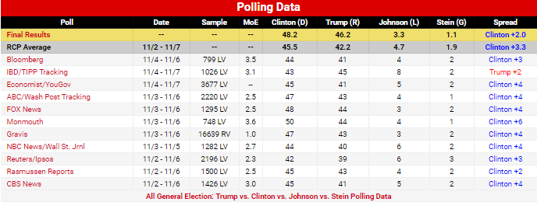
National Vote: Clinton 65.5 mil Trump 62.8 mil (Clinton “wins” by 2.7 mil) National Polls Were Actually Quite Accurate on Average But National Vote Does Not Matter, Electoral College Vote Is Everything!
National Presidential Race: Predicted vs Actual
Real Clear Politics Final Pre-Election Polling Average
Clinton 45.5% to Trump 42.2% Winner Clinton by 3.3%
Actual Results
Clinton 48.2% to Trump 46.2% Winner Clinton by 2.0%
Most polls underestimated vote for both candidates.
Most polls had Trump vote lower than Margin of Error.
Most polls overestimated vote for 3rd Party Candidates.
Late deciders went for Trump.

Slide 4
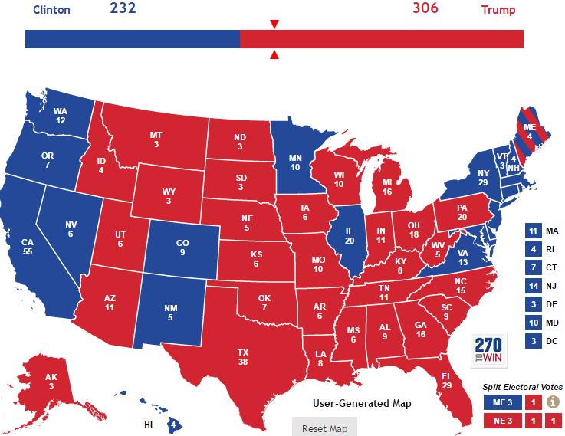
Electoral College (270 to Win): Trump 306* (31 “states”) – Clinton 232 (21 “states”) Some Predicted Close Race (RCP Final No-Toss-Up Map: Clinton 272 to Trump 266) Media Bias & Mistakes: Trump Win Unthinkable, History, & MI, PA, WI Polls Off
Michigan
Pennsylvania
Wisconsin

Slide 5
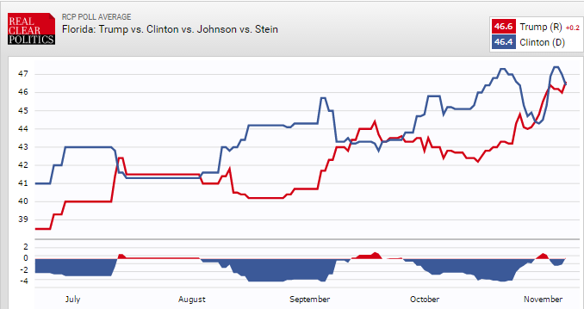
Trumps Wins Florida 4.6 mil to Clinton 4.5 mil Florida Is a Swing State and a Battleground RCP Poll Average Predicted the Winner and Was Accurate
Florida Presidential Race: Predicted vs Actual
Real Clear Politics Final Pre-Election Polling Average
Trump 46.6% to Clinton 46.4% Winner Trump by 0.2%
Actual Results
Trump 48.6% to Clinton 47.5% Winner Trump by 1.1
How did Trump win FL by 1% after Obama won by 1%?
Big surge in white rural and suburban voters.
Kept gender and age gap relatively low.
Kept losses among minorities relatively low (won Cubans)
Late deciders went strongly for Trump
There were 10 lead changes between July and November!
FL’s swing 24 year winning streak: D, R, R, D, D, R (only OH as good)
Average victory margin during streak: <3% (smallest of 50 states)

Slide 6
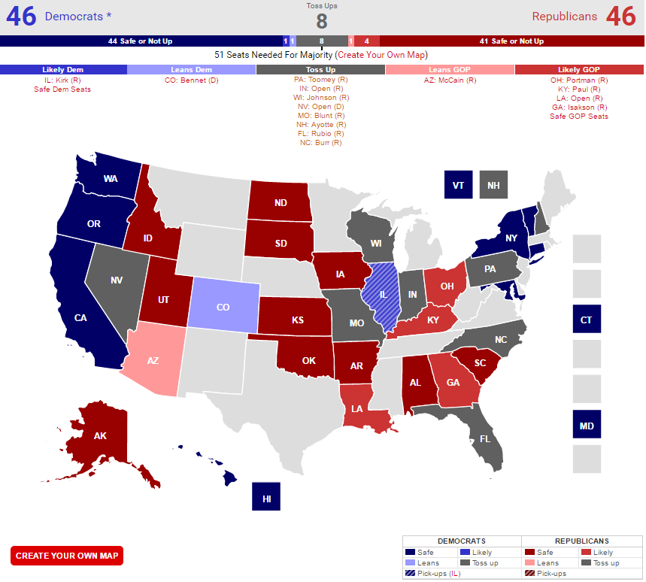
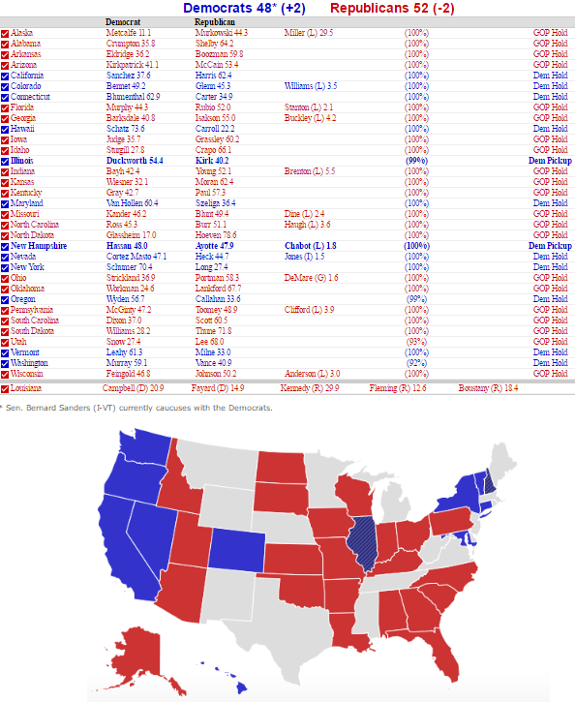
Republicans Maintain Control of the Senate 52 - 48 (Assuming LA to GOP) Democrats Pick Up/Flip Only 2 seats (IL & NH) GOP Wins 6 out of 8 Toss Up Races – Trump Coattails?
RCP Pre-Election Predictions Based on Polls
2016 Senate Election Results (LA Runoff Pending 12/10)

Slide 7
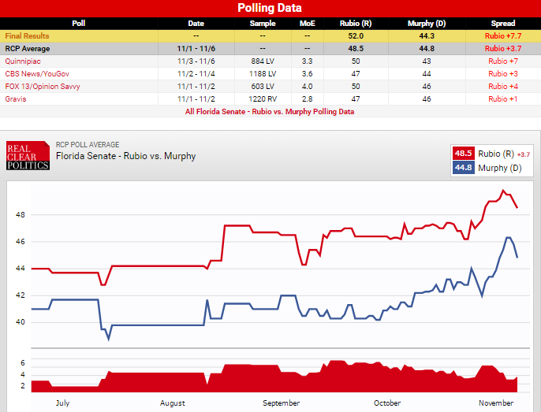
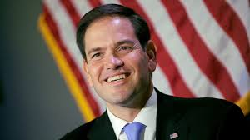
GOP Wins FL US Senate Race: Rubio 4.8 mil to Murphy 4.1 mil. RCP Poll Average Predicted the Winner and Was Fairly Accurate Power of Incumbency for FL Senate Race: Bill Nelson in 2018?
Florida Senate Race: Predicted vs Actual
Real Clear Politics Final Pre-Election Polling Average
Rubio 48.5% to Murphy 44.8% Winner Rubio by 3.7%
Actual Results
Rubio 52% to Murphy 44.3% Winner Rubio by 7.7%
Florida Senate Race Summary
Murphy thought he was getting into an open seat race.
Once Rubio reentered the race he never trailed.
Rubio won by a larger margin than Trump.
Rubio did much better among Hispanics.
Murphy’s outside support waned over last 2 weeks

Slide 8
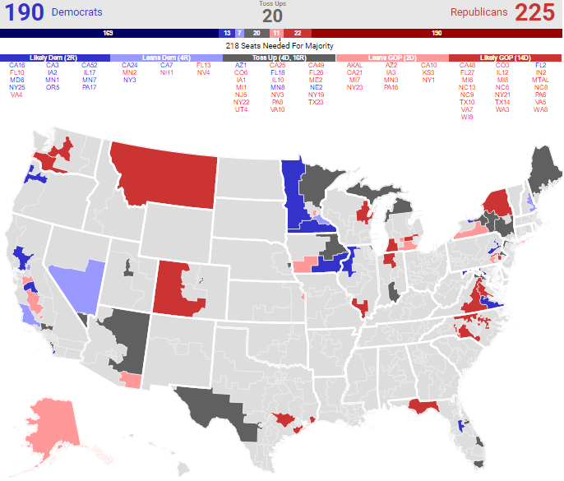
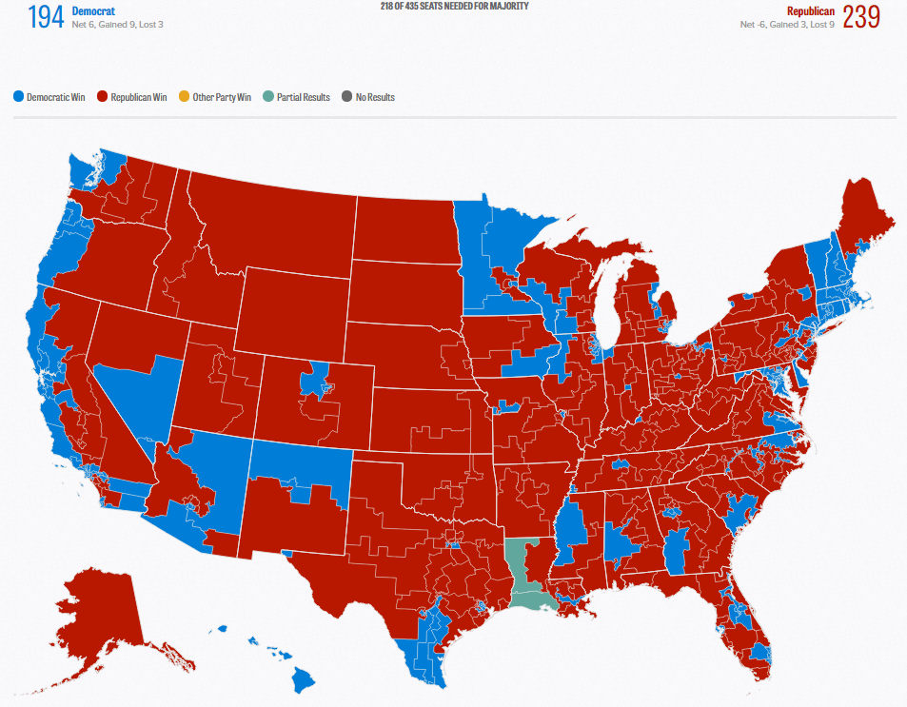
Republicans Maintain Large Majority in US House GOP Wins Most Toss Ups; Dems net gain just 6 seats
Pre Election US House: 246 R to 186 D
RCP Final US House Pre-Election Prediction
2016 US House Election Results: 240 R to 195 D
(Pending Results of 2 LA House Races on 12/10)

Slide 9
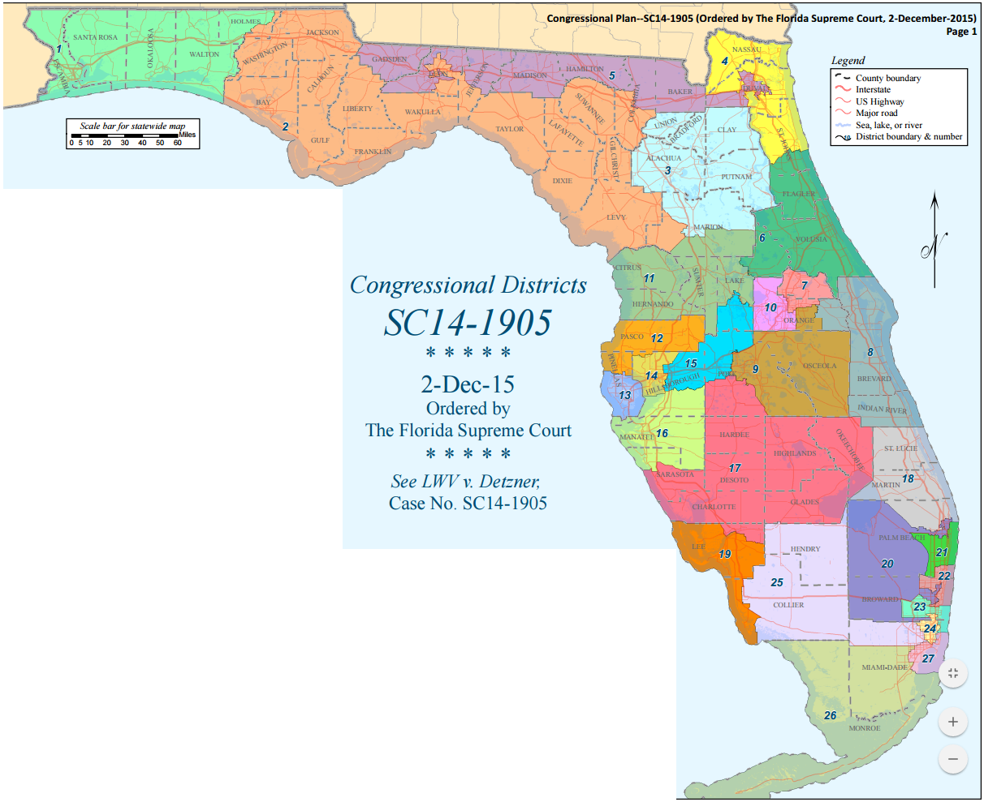
US House: Florida Delegation Pre-Election: 17 Rep.-10 Dem. 2016 Results: 16 Rep.-11 Dem
All FL US House seats redrawn for 2016
Even with Fair Districts Democrats only managed to pick up 1 seat
Fair Districts did create a lot of turnover: 10 new members
Fair Districts did create more diversity: 4 blacks, 4 Hispanics (first
FL Puerto Rican), and 1 Asian (first Vietnamese female in US)
Seats That Switched Party
FL 2 (Gwen Graham, D retires) goes to Republican Neal Dunn
FL 7 (John Mica, R) beaten by Stephanie Murphy (D)
FL 10 (Dan Webster, R moves to FL 11) goes to Val Demings (D)
FL 13 (David Jolly, R) loses to former Gov. Charlie Crist (D)
FL 18 (Patrick Murphy, D ran for Senate). Brian Mast (R) defeats Randy Perkins (D)
Toss Up Seat Held by Incumbent Party
FL 26 (Carlos Curbelo, R) wins rematch against former Representative Joe Garcia (D)

Slide 10
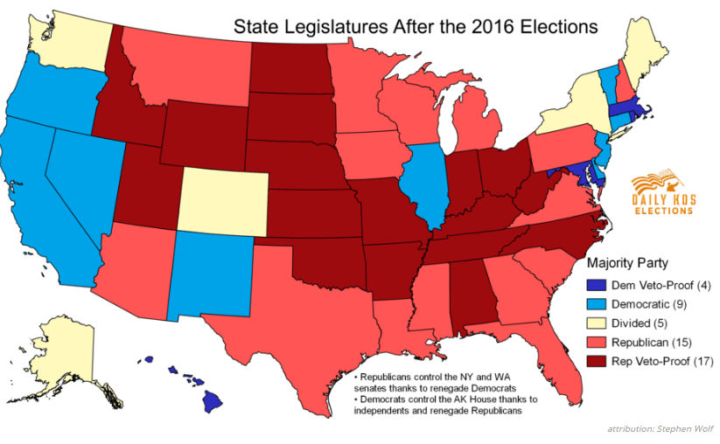
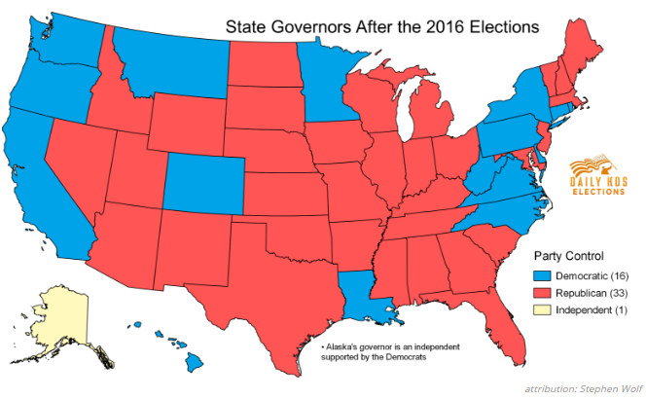
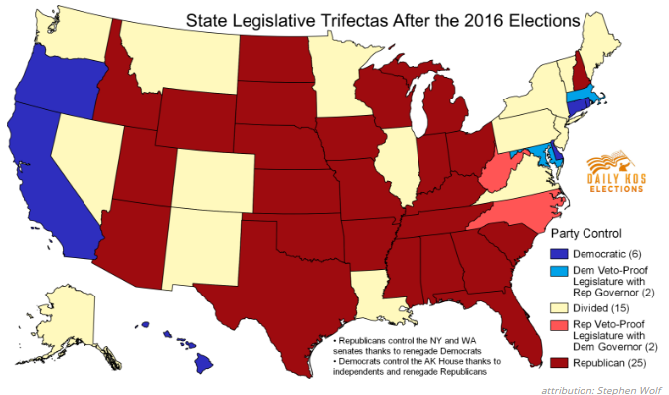
Republican Domination of State Government Nationwide Continues GOP Strength Since 2014 the Highest Since the Civil War
Legislative Chambers: GOP 68 to Dem 31 (2016 Net D +1)
Legislature Both Chambers: GOP 32 to Dem 13
GOP States 61% of population to Dem States 28%
Governorships: GOP 33 to Dem 16 (AK Ind.) (2016 Net R +2)
GOP States 60% of population to Dem States 40%
Trifectas*: GOP 25 outright + 2 to Dem 6 outright + 2
GOP States 56% of population to Dem States 19%
* One party controls legislature and governor’s office outright or has veto-proof legislative majority that can override the governor of the opposite party.

Slide 11
Florida Legislature: Republicans Maintain Strong Majorities Democrats Make Small Gains, Underperform Expectations Voter Registration: Democrats still ahead but GOP cuts lead Other Voters (NPAs and 3rd Parties) Continue Rapid Rise
2016 Election Results Florida House: 79 Republicans to 41 Democrats (Pre-Election 81 to 39). Democratic turnout was expected to be higher than in the 2014 and erase gains made by Republicans in the midterm election. However Dems gained just 2 seats.
2016 Election Results Florida Senate: 25 Republicans to 15 Democrats (Pre-Election 26 to 14). Democrats were expected to close the gap as all Florida Senate seats were redrawn for 2016 because of the Fair Districts lawsuit and 50% had majority Democratic registration. However Dems gained just 1 seat.
2016 Voter Registration: Dem. 37.9%, Rep. 35.4%, Other/NPA 26.7% (2012 D 40.1, R 35.4, O 24.5)

Slide 12
Florida had 4 Proposed Constitutional Amendments on the Ballot! Voters Love Tax Breaks, Give Medical Cannabis a 2nd Look, Defeat Faux Pro Solar
No. 1 Rights of Electricity Consumers Regarding Solar Energy Choice
FAILS 51% Yes – 49% No
No. 2 Use of Marijuana for Debilitating Medical Conditions
PASSES 71% Yes – 29% No
No. 3 Tax Exemption for Totally and Permanently Disabled First Responders
PASSES 84% Yes – 16% No
No. 5 Homestead Tax Exemption for Certain Senior, Low‐Income, Long‐Term Residents
PASSES 78% Yes – 22% No

Slide 13
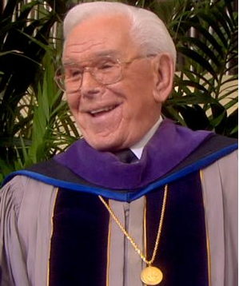
Conclusions: Recap and a Look Ahead
Trump won the electoral college but lost the popular vote (2nd time in 16 years). National polls and most state polls were accurate. Look for attempts to change or work around the Electoral College.
Florida is the most important battleground state and will most likely remain that way for some time. It has the most electoral votes, is evenly divided, and swings!
GOP controls the US Senate & Marco Rubio’s victory helped – will he run for president again? Three term FL Democrat Bill Nelson’s reelection in 2018 is not a given in an off year election.
GOP controls the US House and Florida’s 16 Republican wins helped! Democrats gained one seat in FL (11 total), but may find it hard to hold on to District 10 in the midterm.
GOP has a large majority in the FL legislature. Democrats have long believed gerrymandering was their main problem. But clearly they must look elsewhere to become competitive: candidates, organization, money, & message.
Advice to Republicans: With great power comes great responsibility! (Spiderman / Stan Lee)
Advice to Democrats: Tough times never last, tough people do! (Reverend Robert Schuller)

