Slide 1
Planning and Legal Issues Related to Climate Change
Erin L. Deady, Esq., AICP, LEED AP
December 6, 2017

Slide 2
The Facts About Climate Law, Planning & Policy
Who needs to start planning?
How do we take the science and plan ahead?
What policies do we need to put in place to do that?
What are we required to start doing?
Who’s doing it (so its not so scary)?

Slide 3
Part II- Laws and litigation shaping “climate liability” and responses to changing conditions

Slide 4
US Approach to GHG Reductions
Endangerment finding = 6 GHGs may be reasonably anticipated to endanger public health and welfare, and are emitted from automobiles, which would allow their regulation under CAA section 202
Additional Federal Rulemaking and now “rollbacks”
“Red Team/Blue Team”
Response within U.S. (Prior to Paris):
In 1965 President Johnson’s Scientific Advisory Committee Panel on Env Pollution = unabated CO2 emissions would, by 2000, alter the climate,
Section 1605(b) of the 1992 Energy Policy Act = track GHG emissions and reporting standards
Numerous attempts at Federal legislation
Mass v. EPA: EPA has authority to regulate CO₂ as pollutants based on the definition provided in CAA section 302(g)
7

Slide 5
The Law: Where Does Climate Change Show Up?
ESA
NEPA
CAA
CWA
MMPA
FOIA/1st Amendment
Energy Policy Act
Global Climate Change Research Act
Corporate Reporting/Securities Disclosure
FTC
“Cap-and-trade” regulation where GHGE’s are capped and allocated through the distribution of “allowances” representing a right to emit.
Regulate vehicle standards
Regulate activities (public and private), failing to regulate or regulating too much
Green & Energy Building/Codes (New Mexico case)
Protestors and scientists
Failure to consider climate in permits
Money damages and common law claims
Protect my future
785 total cases as of
June 2017 and its growing
8

Slide 6
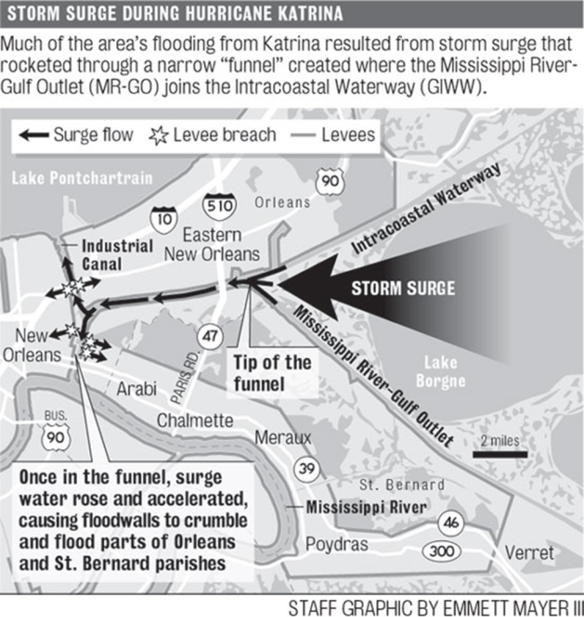
9

Slide 7
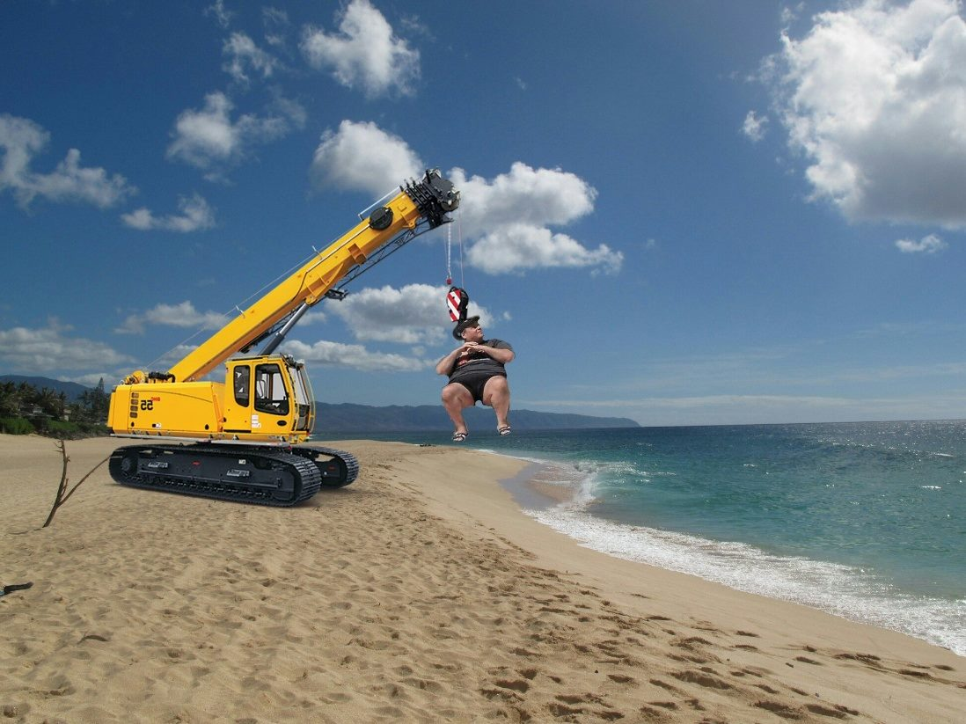
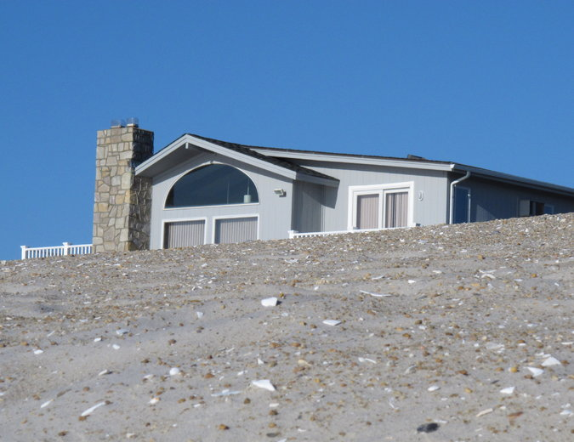
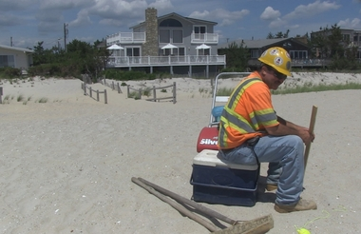
Borough of Harvey Cedars v. Karan
3 story beach front home v. 22’ barrier dune protection project
Without project Karans had 56% chance of storm damage (over 30 years), with it, had 200 year “protection life”
Karans sought to exclude testimony on benefits
Court determines “just compensation” when a portion of private property is taken for a public project – how do you calculate the “benefits”?
Benefits are general or special
Trial jury awarded $375k in just compensation (upheld at appellate level)
NJ Supreme Court says erroneous valuation-- look at FMV before and after project (consider testimony on benefits)
Reverse and remand- so what did they get???????

Slide 8
____________ Plaintiff v. Fossil Fuel Companies
San Mateo County, Marin County and the City of Imperial Beach v. Chevron- (37 D’s) public nuisance, failure to warn, private nuisance, negligence, and trespass- they knew and hid it and now…. energy companies need to pay for the costs the local governments are incurring to adapt to sea level rise and for the companies’ own willful, deceptive, and malicious behavior (filed 7/17/17)
…“coordinated, multi-front effort” to “discredit the growing body of publicly available scientific evidence and persistently create doubt.”
NY State Attorney General email investigations
USSC in Kivalina- if an individual driving a car (and thus contributing to emissions) could also be a defendant, how can a court determine who was liable?
Causation v. “substantial factor”
Vulnerability assessments as evidence?
12

Slide 9
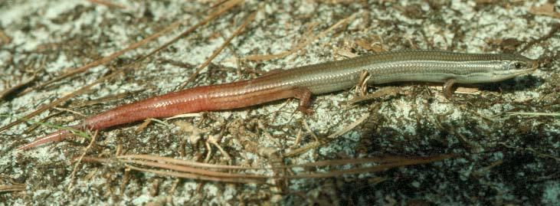
On a Recent Front- Center for Biological Diversity v. USFWS (Potentially?)
April 20, 2010- 2011 movement towards listing and a positive 90 - day finding on listing Florida Keys mole skink (habitat severely impacted- future challenges)
September 23, 2013, stipulated settlement agreement that USFWS would submit a 12 month finding to list the skink by September 30, 2017
October 5, 2017, USFWS issued a finding that listing the Florida Keys mole skink is “not warranted”
CBD files 60 Notice of Intent (11/6/17) to sue USFWS for violations of ESA concerning “not warranted” listing decision
Alleges arbitrary and unlawful decision depriving protection in the face of rising seas and climate change leaving it at risk of extinction
Asserts impacts to remaining habitat from sea level rise
Import- remedies could impact local land use decisions

Slide 10
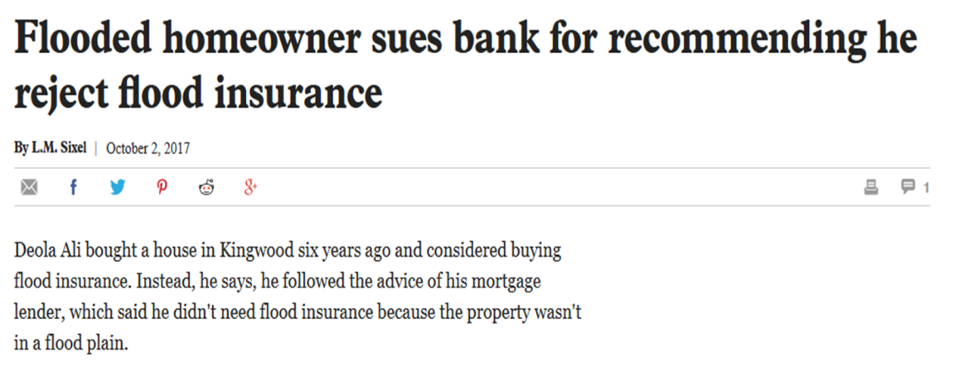
Future Flood Risk Litigation: Trends in Post Storm Theories
Sue the Corps over operations and takings (popular but difficult) ie; TX reservoir releases & Post Katrina
Buy outs (valuation)- Post Sandy
Sue the developer
Sue the mortgage company
Sue proximate property owners
Sue the local or state entity that manages levies, rivers or drainage (inverse condemnation)
14

Slide 11
Other Evolving Legal Aspects
NFIP Reform
Technical Mapping Advisory Council
CRS
Sea Level Rise Credits ~ 500 pts.
Mapping
Corps of Engineers
Previous “Incorporating Sea-Level Change Considerations in Civil Works Programs”
NEPA
FFRMS
Future flood risk
Agency determines whether GHG emissions/climate change impacts would be useful
“Rule of reason” to ensure level of analysis is appropriate
Federal investments implemented through Hazard Mitigation Assistance Grants and the Public Assistance Program
FEMA grants
Improvement of rating score
FIRM Existing Flood Risk
Executive Order revoking FFRMS signed 8/15
Early 2017- CEQ directed to withdraw
Expired 9/30 and reauthorized until 12/8
Band aid or full reform?
Sea level rise calculator (2017) with 3 scenarios
Guidance on Inland Climate Change
Principles for Risk in Planning
Example- County x receives a CRS score of 5, but to improve to a 4, these points are pivotal.
8/2/16 Guidance- # on GHGEs if feasible & indirect effects
Land, land use, construction for “federal projects”
15

Slide 12
Part 2: What’s going on in the State related to planning for these new challenges?
Florida Trend & Associated Press

Slide 13
Basic State Legal Concepts in Government Actions/Liability for Capital Improvements and Roads
1. Maintain v. upgrade obligation? | Generally there is a duty to “maintain” (roads) but no duty to “upgrade”. There is no direct case on duty to maintain or upgrade from sea level rise yet…
2. Planning versus operations. | Duty to maintain or upgrade due to sea level rise could depend on whether decisions are deemed “discretionary planning” actions or “non-discretionary operations/maintenance” actions. Once you build it, you must maintain it with “reasonable care” to function as designed (now it becomes a non-discretionary operations).
3. Sovereign Immunity | Discretionary planning decisions are immune from liability under the Tort Claims Act. Cases have held there is no liability for failure to build, expand or modernize capital improvements, cases have deemed these “planning” actions (road widening). Nor liability for basic design of roadway and decision on whether or not to upgrade (planning level).
But wait, there’s one more thing to consider… government inaction (Jordan v. St. John’s County)…

Slide 14
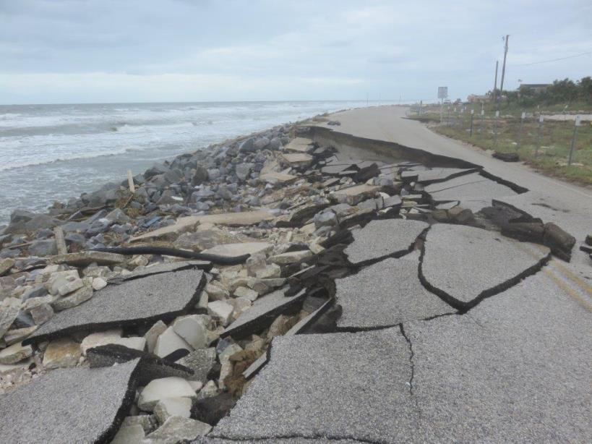
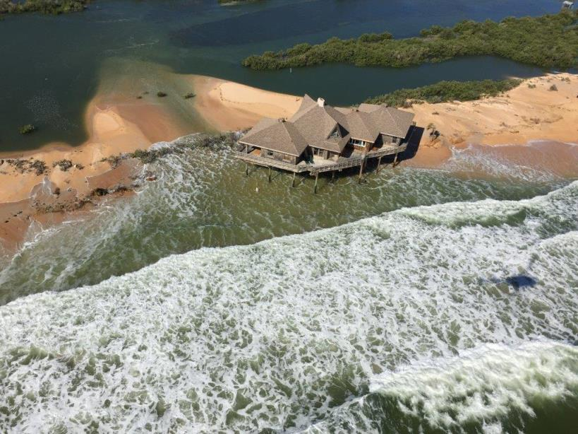
St. John’s County Post Jordan / Post Matthew
County sued for inverse condemnation for failing to maintain old A1A
Trial court finds for County – no duty to maintain
5th District Court of Appeals finds that County “inaction” with regard to maintenance could amount to a take (first ruling ever in Florida advancing this theory)
Case settles (while potentially heading to FL Supreme Court):
County adopts ordinance allowing for environmental conditions designation
Use best efforts to maintain in current condition (as of date of settlement)
Use best efforts to acquire available properties
Photos, Patrick McCormack, Esq.

Slide 15
Florida Policy on GHG Reductions and Climate
EO 07-127: Reduction of emissions to 2000 levels by 2017, to 1990 levels by 2025, and by 80% of 1990 levels by 2050 & California vehicle emission standards reductions (22% by 2012 and 30% by 2016).
Building Efficiencies/Energy Code, Chapter 553, F.S. increasing standards
HB 697 (GHG reduction strategies in local government’s Comprehensive Plan). Some requirements later eliminated.
Adaptation Action Areas (2011)
HB 7117 (Energy Bill- 2012)- increase solar output
2015- 5 Bills Passing Related to flood insurance, wind insurance, construction standards/building codes, Citizen’s insurance, Peril of Flood (SB 1094)
2016- Solar Constitutional Amendments
2017- SB 90 on solar disclosures and Amendment 4 Implementation & Natural Hazards coordination
19

Slide 16
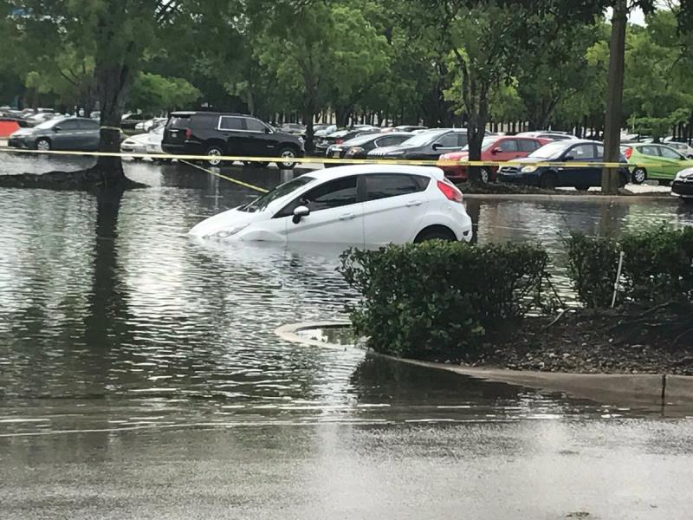
Natural Hazards Coordination- SB 464
“Natural hazards" includes, but is not limited to, extreme heat, drought, wildfire, sea level change, high tides, storm surge, saltwater intrusion, stormwater runoff, flash floods, inland flooding, and coastal flooding
Executive branch, WMDs, PSC and DEM
¼ meetings
Progress reports to Governor, House and Senate
Image: Terrell Forney

Slide 17
What are local governments doing?
Adaptation Action Areas
195 local governments have Coastal Management Element
161 municipalities and 34 counties
As of May 2017:
Approximately 43 (22%) explicitly mention or address sea level rise in their Comprehensive Plans
Eleven (11) mention AAAs in their Comprehensive Plans
Five (5) have a physical designation:
Satellite Beach designates ocean side and bayside AAAs
Village of Pinecrest designates AAAs
Broward County sand bypass project at Port Everglades
Ft. Lauderdale 16 areas 38 stormwater projects
Yankeetown designated natural resource AAA

Slide 18
Flood Peril Legislation (SB 1094)
What are the principle requirements?
1. Principles and strategies, that reduce the flood risk from high-tide events, storm surge, flash floods, stormwater runoff, and the related impacts of sea-level rise.
2. Best practices for the removal of property from FEMA flood zones
3. Site development techniques that reduce flood insurance losses and claims
4. Consistent with, or more stringent than, the flood-resistant floodplain requirements in the Florida Building Code
5. Construction consistent with Chapter 161.
6. Encourage participation in Community Rating System
Development and redevelopment principles, strategies, and engineering solutions that reduce flood risks and losses
Elevation certificates submitted to DEM
“Flexible” flood insurance coverage
Other provisions such as flood insurance policy requirements

Slide 19
Recent and Current EAR Based Amendments
In Compliance with SB 1094
West Palm Beach |  | Yankeetown
Ponce Inlet |  | North Miami
Santa Rosa County |  | Palm Bay
Boynton Beach |  | Clearwater
Jupiter |  | Broward County
Jupiter Inlet Colony |  | Pinecrest
Sunny Isles Beach

Slide 20
Sample Planning Strategy
How do these requirements relate to or affect planning activities and infrastructure investments in the short- and mid-term?
Land Development
Regulations
Development/
Redevelopment Strategies
Comprehensive Plan
Short Term
Compliance (POF) Strategy (timeline and scope)
Frame “development”
Short term capital projects
AAAs
Mid Term
Comp Plan Goals, Objectives and Policies
Review land uses
Long Term
LDRs: Development / design standards
Areas subject to flooding
ESLs
Infrastructure LOS

Slide 21
Example Planning Efforts Around the State (not all listed)
Jurisdiction | Activity
West Coast Southeast Florida | Regional Collaboration and involvement of regional planning councils
Broward | Enhanced modeling: seawall heights and future conditions groundwater maps
Miami Beach | Stormwater pumps, road elevation and seawall policy
Ft. Lauderdale | Adaptation Action Areas (19), seawall ordinances for design criteria
Monroe County | Road elevation policy accounting for sea level rise and demonstration projects & SLR Modeling through CRS (to achieve “4” rating)
East Central FL | Satellite Beach- HAZUS modeling and plan development (new Volusia and Brevard initiatives)
St. Augustine | Historic properties, post-Matthew infrastructure and planning
Multiple Cities/Counties | Sustainability/Climate/Vulnerability planning initiatives (Central FL, West Coast, South Florida)
DEO | Pilot / demonstration vulnerability analyses in 3 communities

Slide 22
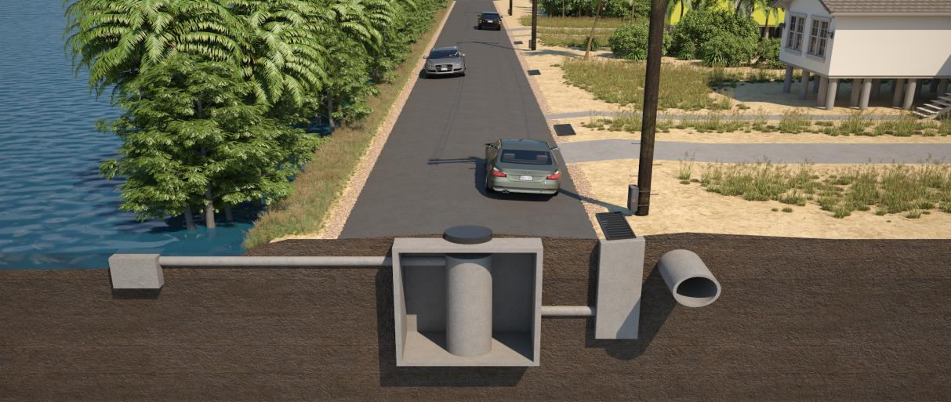
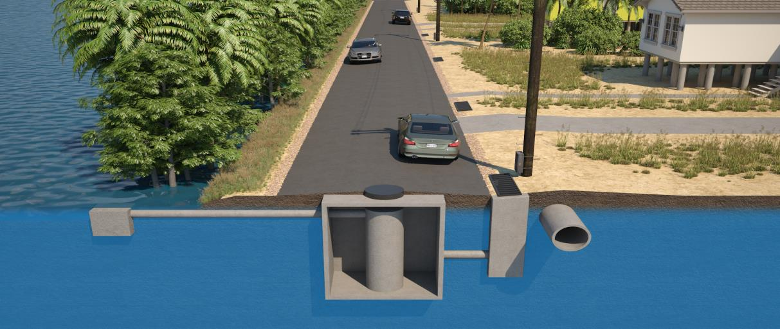
Monroe Road Elevation Considerations
LOCAL CONDITIONS AFFECTING FINAL DESIGN RECOMMENDATIONS
Sensitive Lands /
Mitigation
Roadway Elevation & Condition
Adjacent Property Elevation
Future Sea Level Rise
Driveway Access
Space for Drainage Improvements
ROW Requirements
Electrical And Water/Sewer Utilities
Elevation of Water Table
Water Quality Requirements For Permitting
Stormwater System Maintenance Costs Including Staff

Slide 23
Initial Results – Elevation Conceptual Cost Estimates
 | Twin Lakes – Key Largo |  | Sands Community – Big Pine
Elevation | Length of Roadway Elevated | Total Roadway and Drainage Cost | Length of Roadway Elevated | Total Roadway and Drainage Cost
6" | 0.25 miles | $0.92 million | 0.3 miles | $2.22 million
12" | 0.7 miles | $4 million | 0.35 miles | $2.63 million
18" | 0.8 miles | $5.8 million | 1.3 miles | $8.9 million
28" | 0.9 miles | $7.3 million | 1.5 miles | $10.5 million
Costs factored in: Maintenance of traffic, mobilization, design, construction, 15% of costs for construction engineering and inspection, 25% contingency and stormwater features.
Costs not factored in: right-of-way (~12” is threshold), driveway improvements
Notes:
To wrap all of the previous conversation up into one basic conclusion – addressing tidally induced flooding in the two communities being studied has elements of elevation, extent of roadway to be raised, and also Stormwater quality requirements.
You can see the effect of various decisions here on potential project costs. As the length of roadways increase, and the amount of elevation also increases, so do the project costs of implementation in each community.

Slide 24
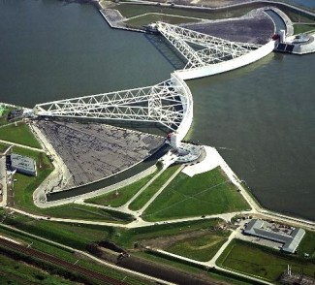
Some Solutions
Immediate, case specific:
Work with stakeholders to design upgrades (recognizing new inherent obligations to maintain)
Capital planning & funding: general revenue, special assessments, infrastructure bond referenda, etc.
Special assessments can apportion risk (similar to CPTED or neighborhood improvement assessments)
Referenda can require voter support (Miami Forever $400M)
Doing nothing can risk bond ratings (Moody’s “Climate Change & Sovereign Credit Risk”)
Better regulations and incentives:
Integrate “future conditions” into permitting
Old Ex: FFRMS (government buildings/facilities)
Ex: Broward groundwater capacity
Monroe County Road Design criteria
“Above code” resilience incentives- FORTIFIED
25

Slide 25
Public Trust Theories- Juliana v. U.S.
Plaintiffs- young people ages 8-19, Earth Guardians and Dr. James Hansen (acting as guardian)
Allegations- fossil fuels burn carbon, U.S. allowed emissions to get out of control and they sought: (1) a declaration their constitutional and public trust rights have been violated and (2) an order enjoining defendants from violating those rights and directing defendants to develop a plan to reduce C02 emissions
Defendants – US, DOE, EPA, OMB, etc. filed MTD

Slide 26
US: Your MTD is DENied
Federal defendants file Writ of Mandamus to stay proceeding and evaluate denial of MTD filed 6/9/17- hearing next week
11/10/16 – “The questions before the Court are: 1) whether defendants are responsible for some of the harm caused by climate change, 2) whether plaintiffs may challenge defendants' climate change policy in court, and 3) whether this Court can direct defendants to change their policy without running afoul of the separation of powers doctrine.
Fossil Fuel companies intervene and withdraw (after MTD denied)
See you in court? 2/5/18?

Slide 28
Thank You erin@deadylaw.com www.erindeadylaw.com

